Slide 1
AADT Dashboard
Aditya Marathe
Arizona State University
Acknowledgement
Dr. Xuesong Zhou
Dr. Baloka Belezamo

Slide 2
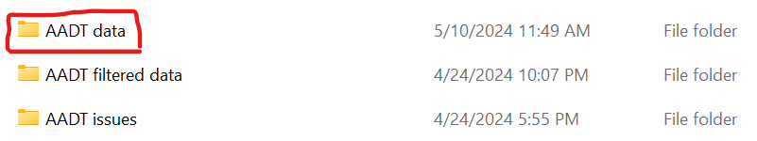
Brief Introduction
Requirements
Python 3.x
Dash python package
Pandas python package
Procedure
Place the AADT excel files into the folder called ‘AADT data’ and run the python program in a compiler.
The program will iterate through each excel file and performs one of the following based on the conditions.
The file is saved under ‘AADT filtered data’, if the file contains all the necessary headers and does not contain any invalid AADT data. The saved file is allowed to be displayed on the dashboard.
The file is saved under ‘AADT issues’, if the file contains all the necessary headers but also contains invalid AADT data. The saved file contains only the invalid data, and is not allowed to be displayed on the dashboard.
The file is not saved and a message will be displayed, if the file does not contains all the necessary headers.
Open a web browser and go to ‘http://127.0.0.1:8050/’ to view the dashboard.

Slide 3
Brief Introduction
The AADT dashboard, previously AADT forecaster, can display the forecasted AADT data for the selected route, milepost range and projection years
Reason
Engineers request ADOT for the AADT data for their desired route, BMP, EMP and projection years
Requests are tedious to fulfill as they require manual calculations
Solution was to create an automated platform to fulfill such requests
First idea was to use Excel Spreadsheet
Unsynchronized data
Dependent on excel version
Second idea was to use a shared Google Sheets
Cumbersome
Shared use
Pseudo automation
Final idea was to use Python to design an online-accessible Dashboard

Slide 4
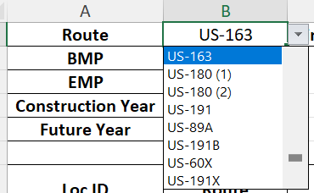
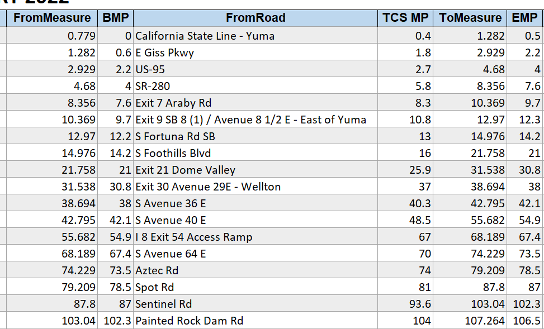
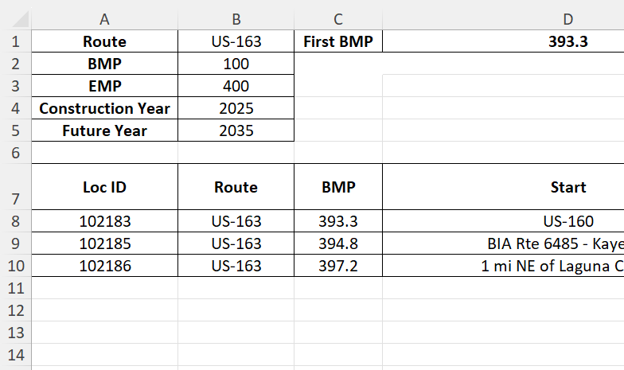
Excel spreadsheet
Features
Automated forecasting
Data filtering
Issues
Cumbersome
Unsynchronized
Harder to update
Limited accessibility
Version history
Ability to forecast AADT based on user input years
Ability to filter the data based on route, BMP and EMP
Display the required data only, filtering out unnecessary data
Display first BMP and last EMP for selected route
Colors for better visual clarity

Slide 5
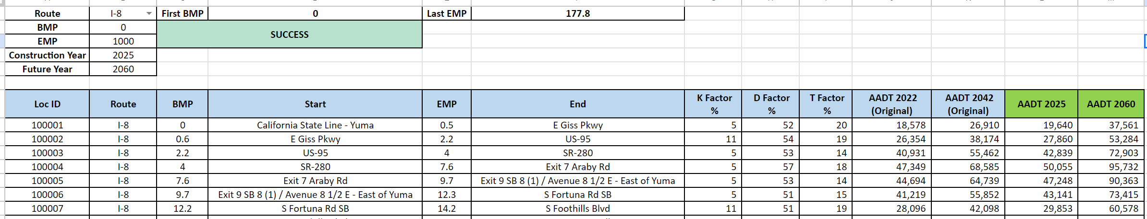
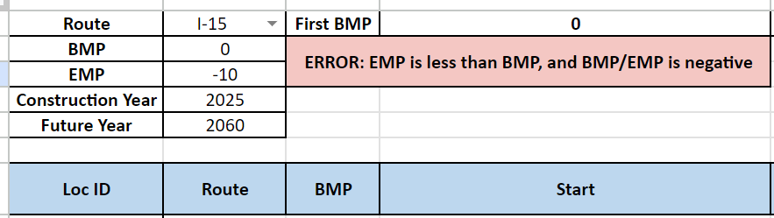
Google Sheets
Features
Automated forecasting
Data filtering
Synchronized
Centralized data
Issues
Cumbersome
Harder to update
Shared use
Version history
Version transfer from excel version
Better visual features
BMP - EMP flexibility
Optimized calculations

Slide 6
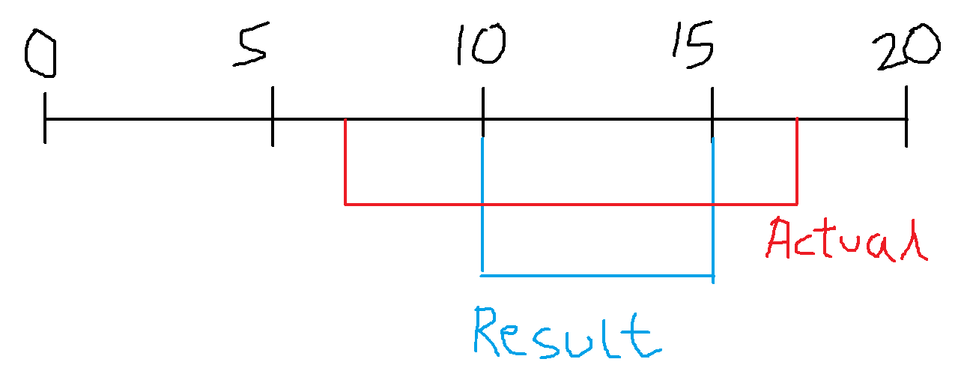
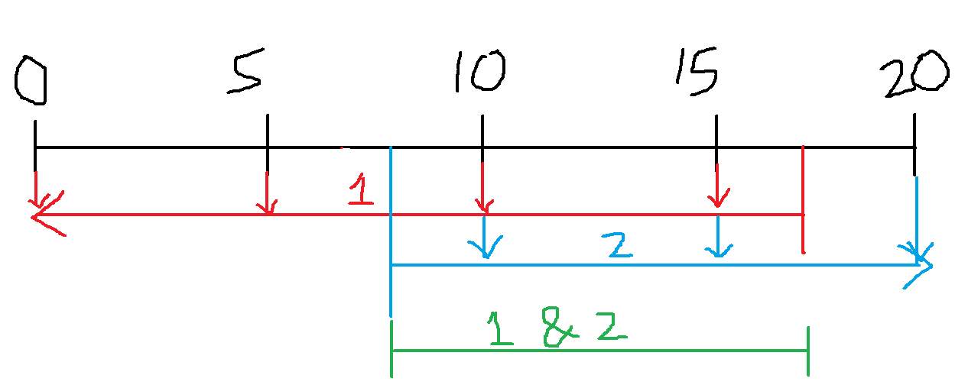
BMP – EMP flexibility logic
Problem: Filtered data was too rigid, which lead to erroneous data display
Example: Assume route segments with mile posts 0, 5, 10, 15 and 20
If the input was, inBMP = 7.5, inEMP = 17.5, then the result should include all route segments between
BMP-5 & EMP-10
BMP-10 & EMP-15
BMP-15 & EMP-20
However, only the route segment BMP-10 & EMP-15 was displayed, which is not correct
Logic Fix
(BMP < inEMP)
(EMP > inBMP)

Slide 7
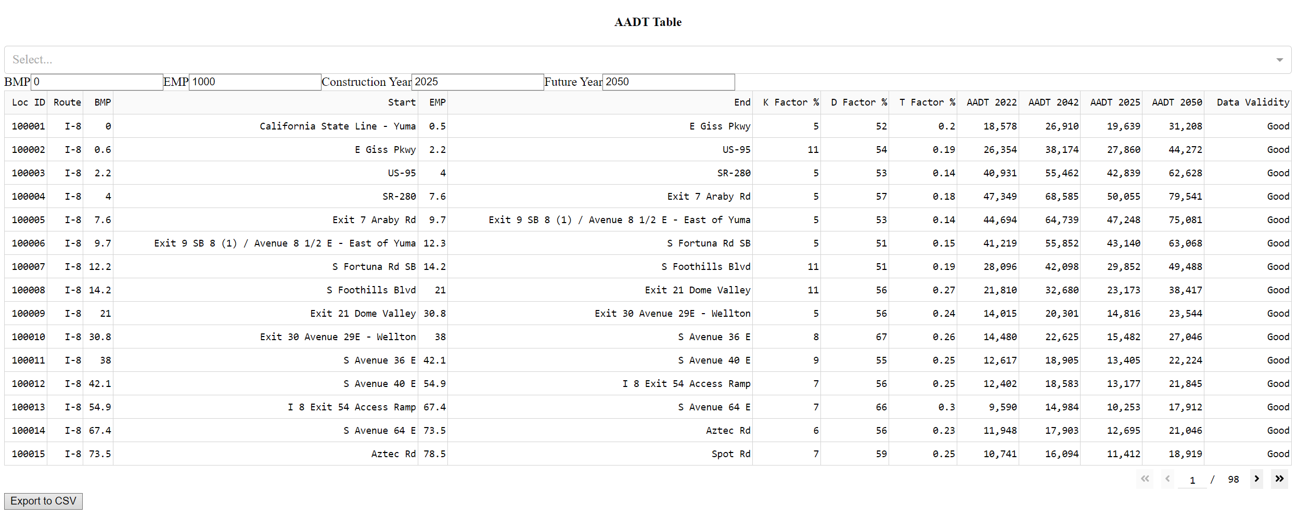
Dashboard
Features
Automated forecasting
Data filtering
Synchronized
Centralized data
Easy to update
Potential
Faster calculations
Visualization options
Larger design options
Easy accessibility
Customization
Version history
Display AADT table similar to other versions
Dropdown, inputs and limiters
Download function
Added commas to AADT values for better clarity
Automated dataframe and header generation
Data cleaning and validation

Slide 8
THANK YOU

